Slide 1

Web Simulation of a Thymio Robot Quentin Flückiger Fall 2019

Slide 2
Thymio ease the entry
Into the information
Technology world

Slide 3
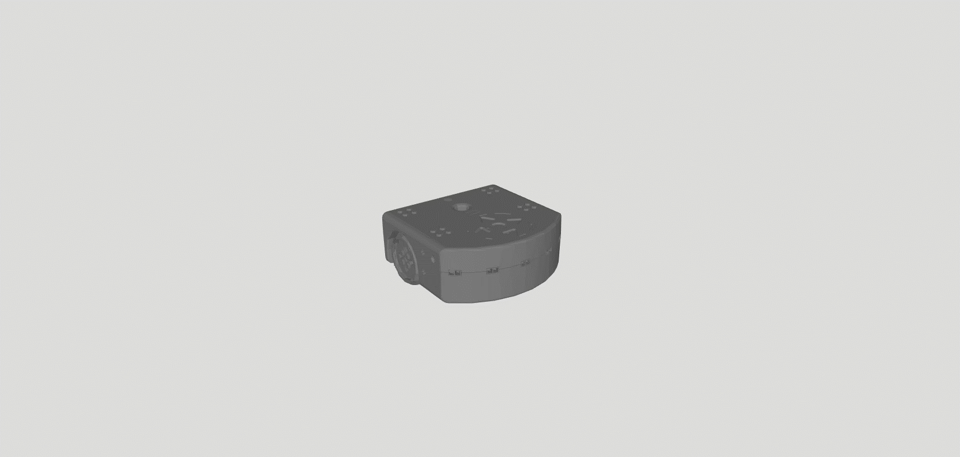
Thymio II

Slide 4
Although Thymio is great
It takes space and
Has material restriction

Slide 5
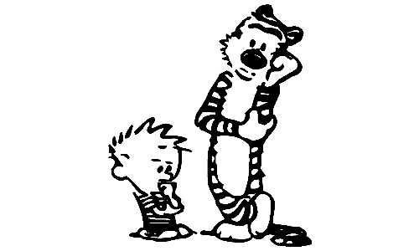
?

Slide 6


Slide 7
Web Simulation

Slide 8
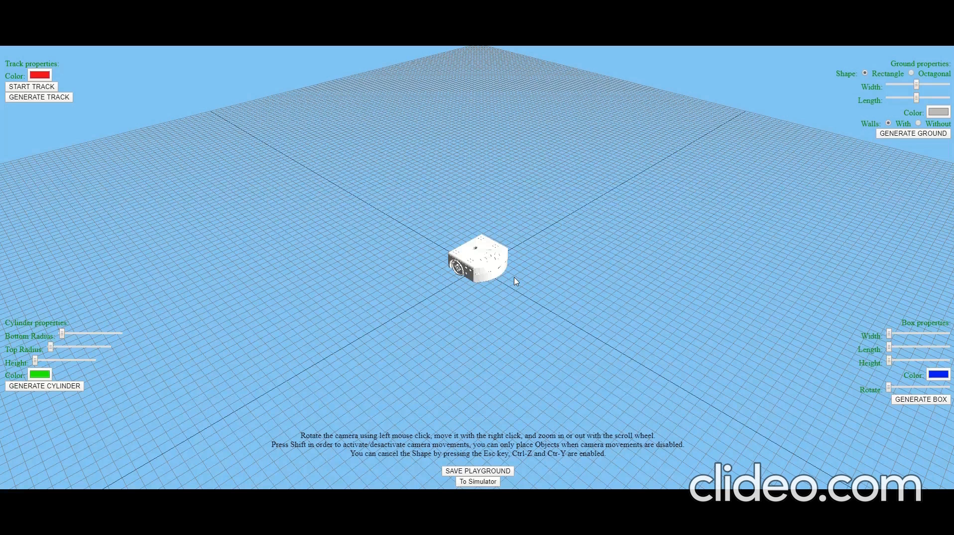

Slide 9

Quentin Flückiger

